Slide 1
Text Mining & NLP Intros
Ted Kwartler

Slide 2











Ted Kwartler, FCTO
MBA
Work
Teaching
Advisory Roles

Slide 3
Dates Review
https://github.com/kwartler/Odum_Feb_23
Date | Time (EST) | Topic
Prework (Optional but encouraged!) | NA – URL: check the git repo | Git setup R, R-studio set up R for text basics & R basics
February 6, 2023 | 12-2:30pm | Transform & mine a text file String manipulation, text processing DTM/TDM, WFM, visuals
February 8, 2023 | 12-2:30pm | Statistical Models Unsupervised methods Supervised methods
February 10, 2023 | 12-2:30pm | ESG, Responsible AI APIs & Google NLP API Web scraping basics

Slide 4
Community Learning Expectations
I expect:
Kindness > Cleverness
Active learning & participation
To make adjustments along the way so learning will be engaging & fun
Academic rigor
My goal for your learning experience is that the topics are:
Interesting
Applicable as a future business leader
Perspective building as a consumer affected by these methods

Slide 5
My style
You learn from being challenged
This is a intensive class course requiring programing & I expect you to actually learn something..
It can be uncomfortable learning something new.
Discomfort means you are applying/challenging yourself. It’s ok and expected.

Slide 6

Some motivation
If you are struggling, ask Prof help, evening labs, lunchtime office hours, email or even smoke signals, whatever it takes to succeed.
Focus on your learning outcomes

Slide 7
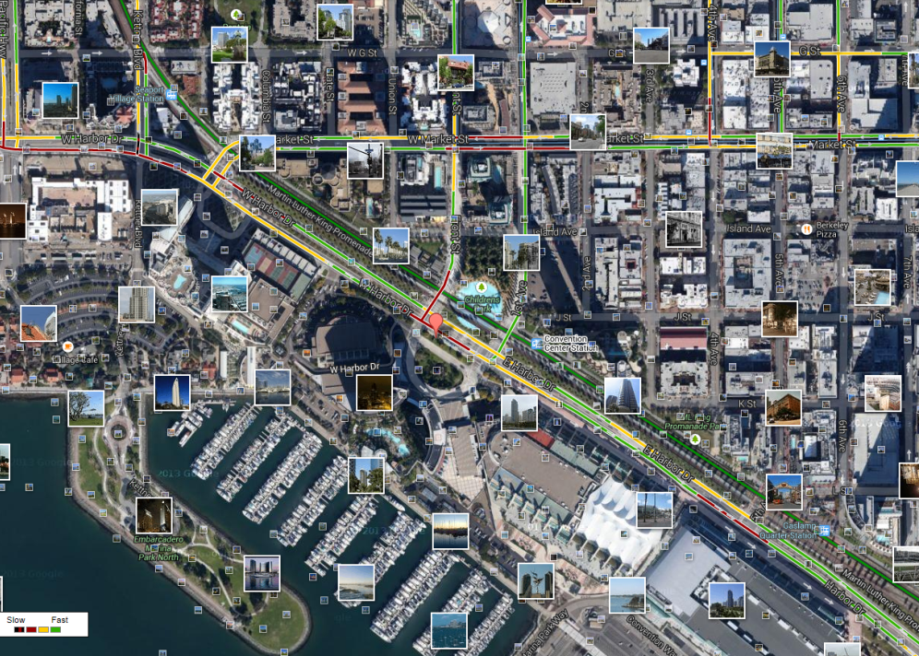
What is Text Mining?
Before Text Mining
Extract new insights from text
Let’s you drink from a fire hose of information
Language is hard; many unsolved problems
Unstructured
Expression is individualistic
Multi-language/cultural implications

Slide 8
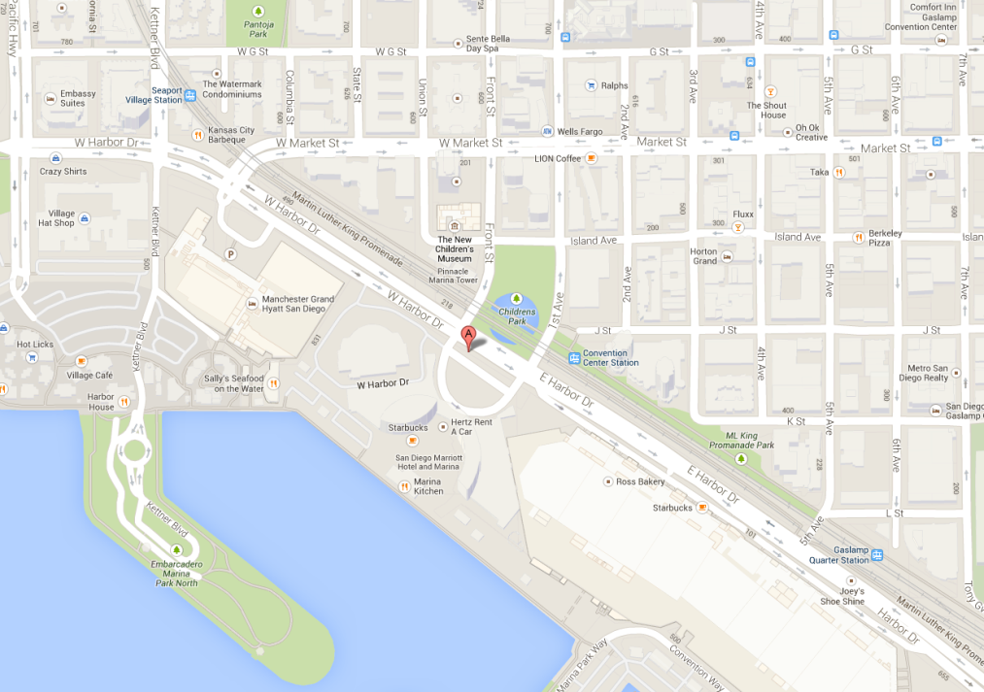
What is Text Mining?
After Text Mining
Extract new insights from text
Let’s you drink from a fire hose of information
Language is hard; many unsolved problems
Unstructured
Expression is individualistic
Multi-language/cultural implications

Slide 9
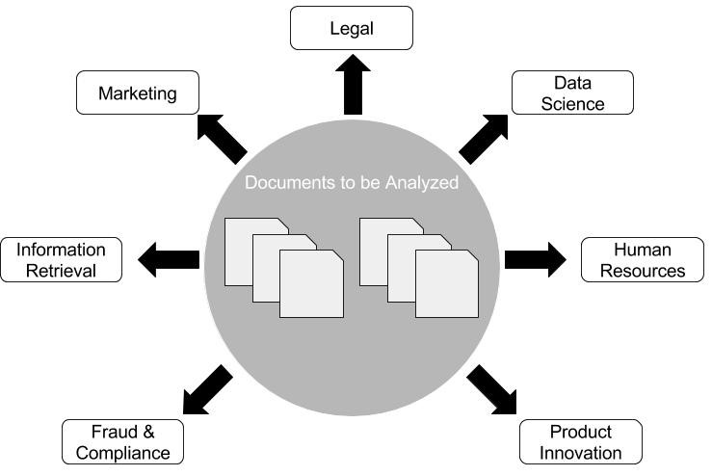
Where can NLP & Text Mining be used? Anywhere there are documents!

Slide 10
What uses of text mining & NLP do you observe, research or want to do?

Slide 11
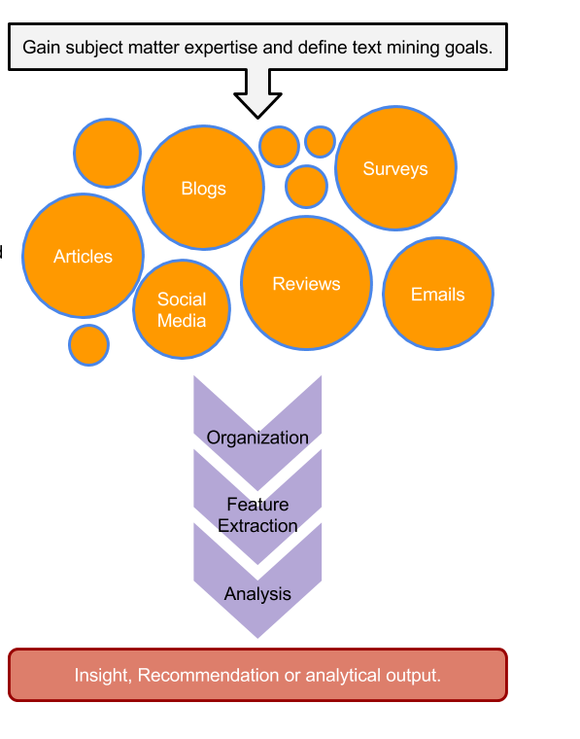
TM Project Workflow
Unorganized State
Natural Language Processing & Analysis
Organized State

Slide 12
Text Mining Workflow
Problem Definition
Identify Text Sources
Text Organization
Feature Extraction
Analytics
Reach Insight or Recommendation

Slide 13
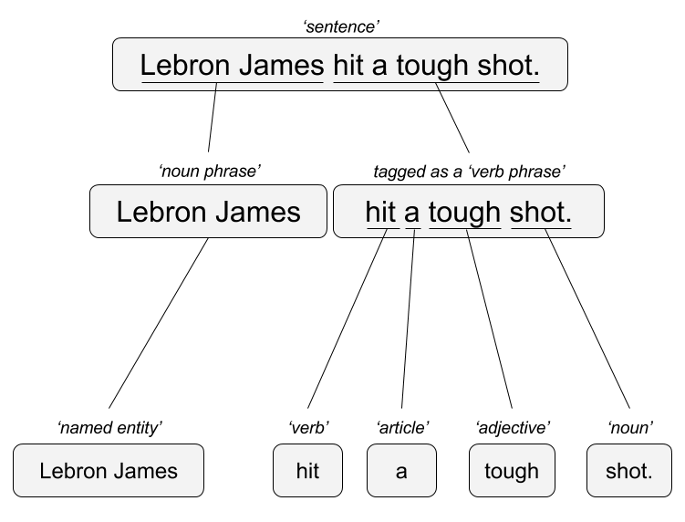

Two Popular Approaches
“Lebron James hit a tough shot.”
Syntactic Parsing
Bag of Words
Lebron
a
James
hit
tough
shot
*There are other approaches usually based on DNN, that I refer to “abstractive”

Slide 14


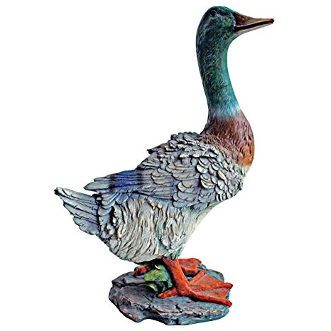

TM Challenges - Disambiguation
I made her duck.
I cooked waterfowl for her to eat.
I cooked waterfowl belonging to her.
I created the (clay?) duck and gave it to her.
Duck!!

Slide 15
TM Challenges - Misc
Other Challenges
Examples
Compound words (tokenization) change meaning
Sarcasm
Cultural differences
“Bad” vs “not bad”
“I like it…NOT!”
“It’s wicked good” (in Boston)

Slide 16





Why text mining is an art & science?
Challenges because human expression is diverse, often ambiguous, affected by age, demographics, socio-economics, medium/channel & regional attributes of the author.
Common Sources
Source & context are important, directly impacting data integrity.
Books
Electronic Docs (PDFs)
Blogs
Websites
Social Media
Customer Records
Customer Service Notes
Notes
Emails
Legal Documents
…

Slide 17



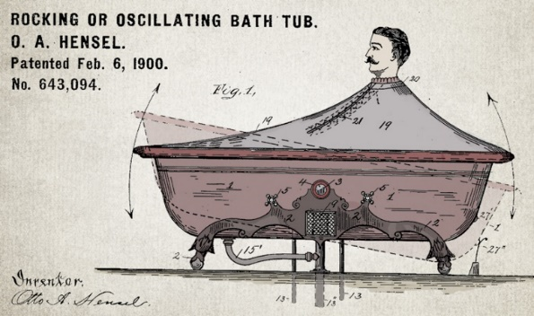


Channel affects language
Legal documents are verbose & technical.
“Be the change you want to see in the world.”
“kappa” indicates sarcasm, irony,
or a joke among online gamers.
Expression is context specific making analysis challenging.

Slide 18



Messenger affects language
Boomers 1946-1964
* Make a difference * Consensus/team * Experiment/try new things * “Imagine if…” * Save time * Features and benefits
Gen X 1965-1980
Best, finest, world-class
“You will benefit by…”
”This is in your best interest.”
Gen Y 1981-2000
Global citizen
Balance
Diversity
Community/connections
Beyond generation, other factors like socio-economic, gender & demographic makeup impact expression.
https://www.anneloehr.com/

Slide 19


Gen Y/Z expression is evolving rapidly due to technology.
“Thank you, next.”
“Woke”
“Cray”
“Gucci”
“Squad goal”
“Bible…”
“Adulting”
“Turnt”
“Hundo P”
“Trill”
“TFW”
Beyond generation, other factors like socio-economic, gender & demographic makeup impact expression.

Slide 20
Gen Y/Z expression is evolving rapidly due to technology.
“Thank you, next.” – moving on with positive connotation
“Woke” - The more woke one is, the more sympathetic & knowledgeable one is about a topic or type of person
“Cray” - crazy
“Gucci” – fine, good
“Squad goal” – friend group behavior
“Bible…” - what follows is TRUTH
“Adulting” – activities associated with growing up
“Turnt” – “turned up” i.e. really excited
“Hundo P” – agree “100%”
“Trill” – True & Real
“TFW” – “That Feeling When” to describe an emotion
Beyond generation, other factors like socio-economic, gender & demographic makeup impact expression.

Slide 21




Audience affects language
And we all context switch based on who we’re are speaking too.

Slide 22
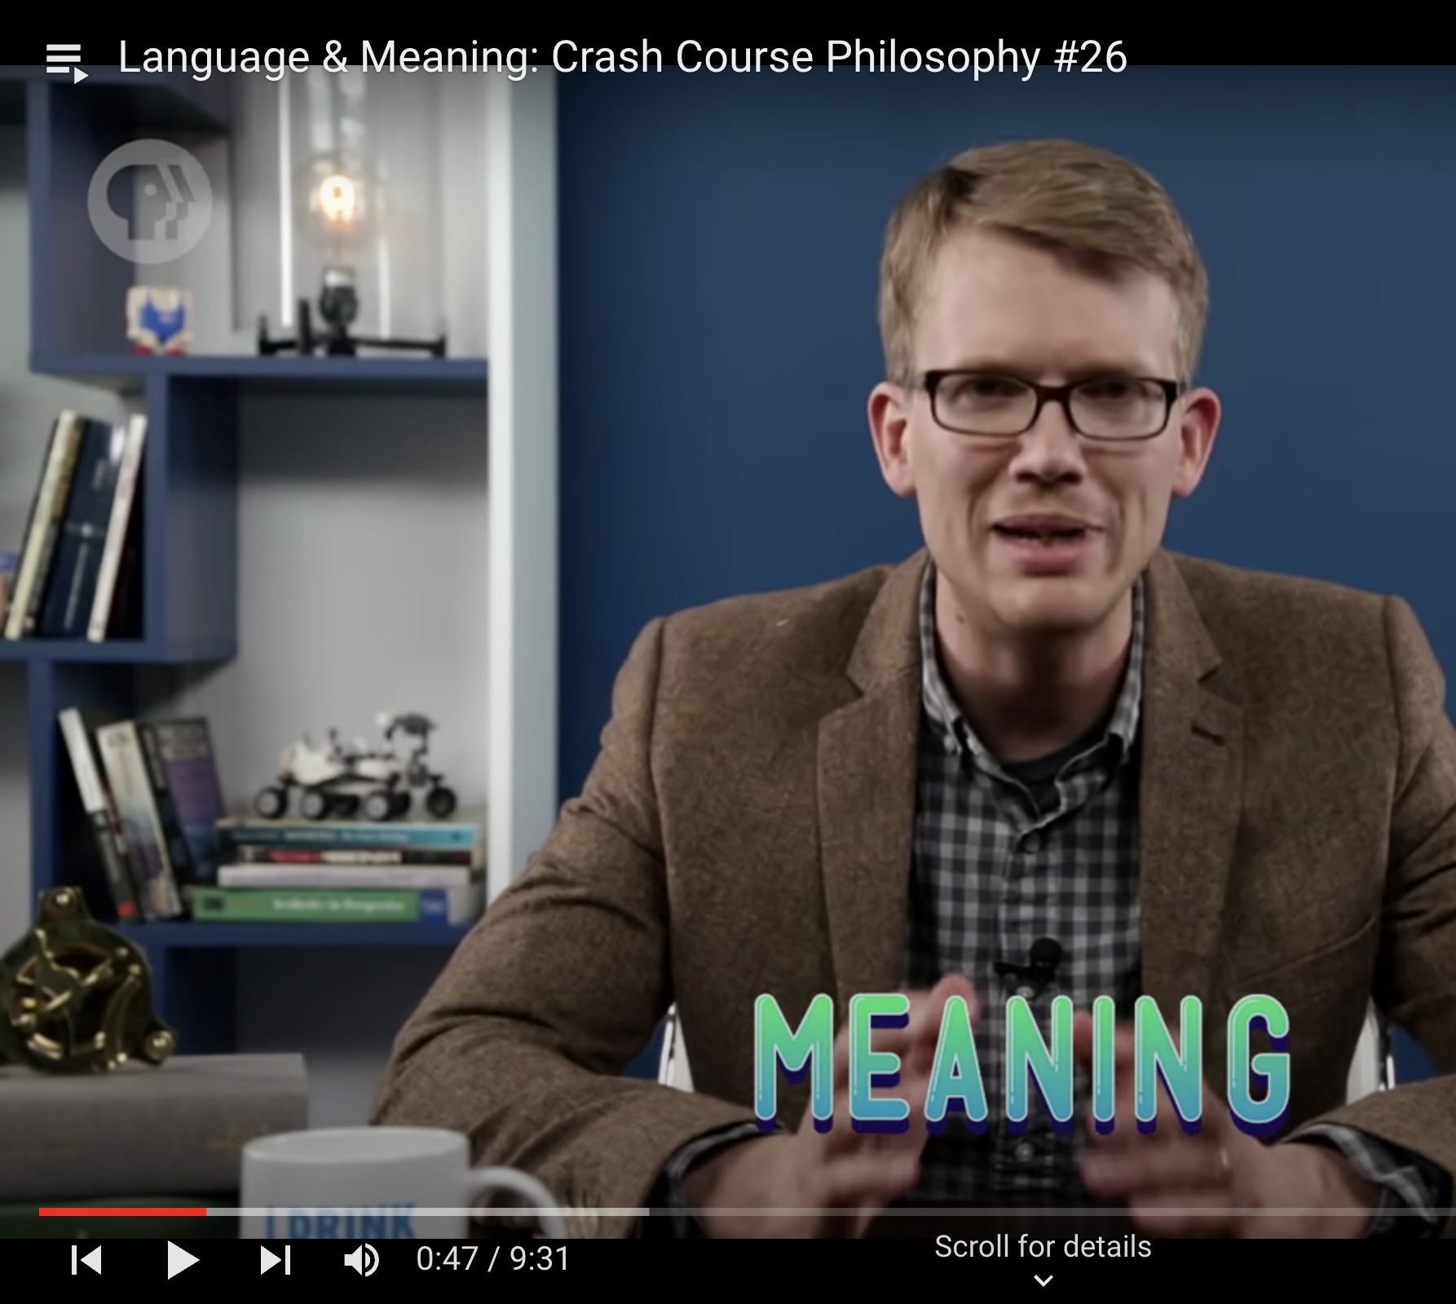
So you may be asking…
NLP and Language is hard, where does word meaning come from?
https://www.youtube.com/watch?v=zmwgmt7wcv8&list=WL&index=1&ab_channel=CrashCourse

